Slide 1
Objectives
Section 1 The Nature of Animals
Chapter 32
Identify four important characteristics of animals.
List two kinds of tissues found only in animals.
Explain how the first animals may have evolved from unicellular organisms.
Identify four features found only in chordates.
Identify two functions of the body cavity.
List the structural features that taxonomists use to classify animals.

Slide 2
Characteristics
Section 1 The Nature of Animals
Chapter 32
_____________________ are multicellular heterotrophic organisms that lack cell walls.
Most members of the animal kingdom share other important characteristics, including:
sexual reproduction
movement
___________________ have a backbone.
Invertebrates do not have a backbone.
Invertebrates account for more than ____ percent of all animal species alive today.

Slide 3
Characteristics, continued
Section 1 The Nature of Animals
Chapter 32
Multicellular Organization
Each cell in an animal body depends on the presence and functioning of other cells.
In all but the simplest animal phyla, there is specialization among cells.
A __________ is a group of similar cells, held together by cell junctions, that perform a common function.
_____________are composed of more than one type of tissue and are specialized for a certain function.
Multicellularity and cell specialization have enabled organisms to adapt to many environments.

Slide 4
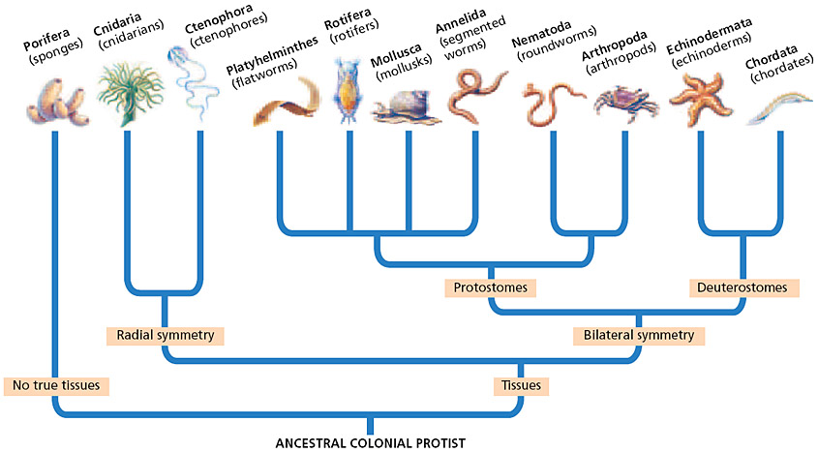
Evolutionary Relationships in the Animal Kingdom
Section 1 The Nature of Animals
Chapter 32

Slide 5
Characteristics, continued
Section 1 The Nature of Animals
Chapter 32
Heterotrophy
Animals are heterotrophic. They obtain complex organic molecules from other sources, usually by ingestion.
Sexual Reproduction
Most animals can reproduce sexually, and some can also reproduce asexually.
In sexual reproduction, two haploid gametes fuse to form a ____________ that undergoes repeated mitotic divisions.
The enlarging mass of dividing cells undergoes ______________.
Movement
Most animals move about in their environment.
The ability to move results from the interrelationship of muscle tissue and nervous tissue, or neurons.

Slide 6
Origin and Classification
Section 1 The Nature of Animals
Chapter 32
The first animals may have evolved from colonial protists.
Taxonomists have grouped animals into several phyla by comparing their:
fossils
body symmetry
patterns of embryo development
macromolecules, such as rRNA

Slide 7
Origin and Classification, continued
Section 1 The Nature of Animals
Chapter 32
Invertebrates
Invertebrate body plans range from:
lack of symmetry and lack of true tissues
to:
________________________and specialized parts
Chordates
All chordates have, at some stage in life:
a _____________
a ____________________
a postanal tail
pharyngeal pouches

Slide 8
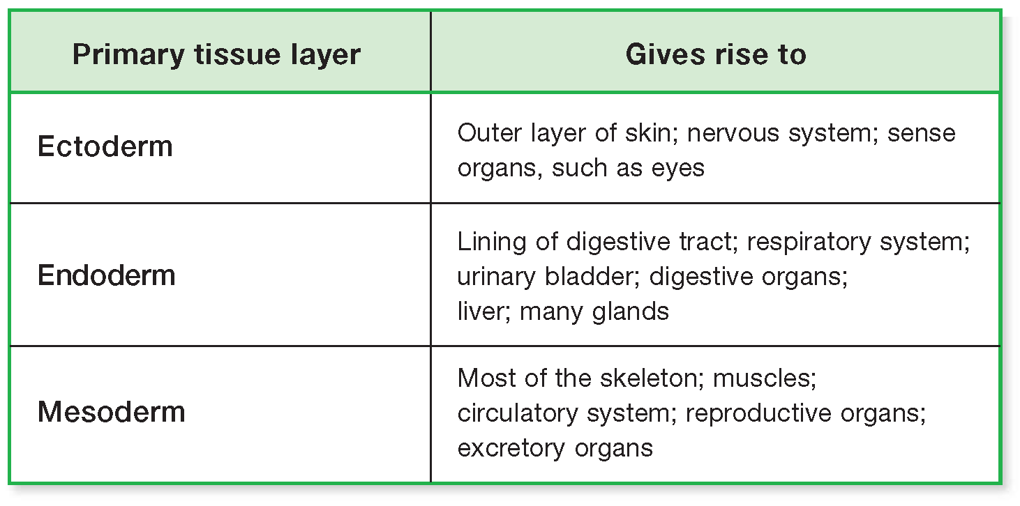
Origins of Animal Tissues and Organs
Section 1 The Nature of Animals
Chapter 32

Slide 9
Body Structure
Section 1 The Nature of Animals
Chapter 32
Patterns of symmetry
Symmetry is a body arrangement in which parts that lie on opposite sides of an axis are identical.
Types of symmetry are:
no Symmetry (asymmetrical)
radial symmetry- pizza-
bilateral symmetry, which includes:
a __________ (back) side and a _______ (abdomen) side
an ___________ (head) end and a ___________ (tail) end
a right side and a left side
Bilaterally symmetrical animals tend to exhibit _________________.

Slide 10
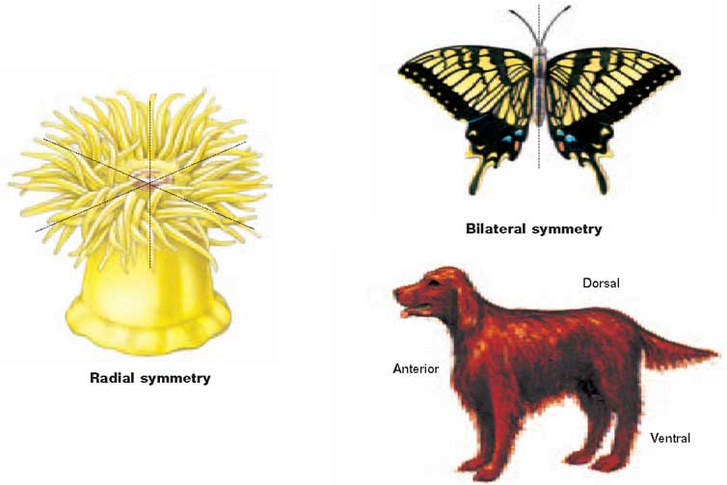
Radial and Bilateral Symmetries
Section 1 The Nature of Animals
Chapter 32

Slide 11
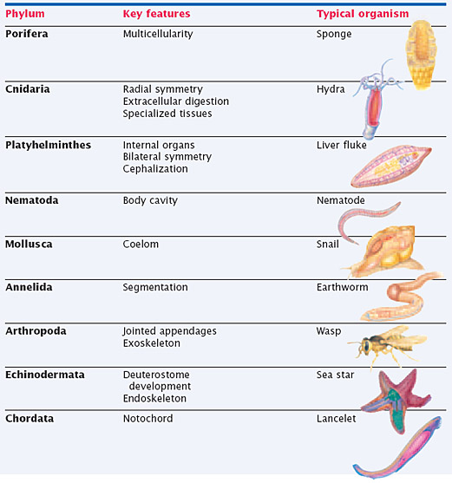
The Animal Body: An Evolutionary Journey
Section 1 The Nature of Animals
Chapter 32

Slide 12
Objectives
Section 2 Invertebrates and Vertebrates
Chapter 32
Compare symmetry, segmentation, and body support in invertebrates and vertebrates.
Describe the differences in the respiratory and circulatory systems of invertebrates and vertebrates.
Compare the digestive, excretory, and nervous systems of invertebrates and vertebrates.
Contrast reproduction and development in invertebrates and vertebrates.

Slide 13
Invertebrate Characteristics
Section 2 Invertebrates and Vertebrates
Chapter 32
Adult invertebrates show a tremendous amount of morphological diversity.
Invertebrates may be characterized in terms of their:
Symmetry
Segmentation
Support of the Body
Respiratory and Circulatory Systems
Digestive and Excretory Systems
Nervous System
Reproduction and Development

Slide 14
Invertebrate Characteristics, continued
Section 2 Invertebrates and Vertebrates
Chapter 32
Symmetry
Most invertebrates display either radial or bilateral symmetry.
Radial symmetry allows an animal to receive stimuli from all directions.
Bilateral symmetry is an adaptation to a more motile lifestyle.
Bilateral symmetry allows for cephalization, which is present in varying degrees in different animals.

Slide 15
Invertebrate Characteristics, continued
Section 2 Invertebrates and Vertebrates
Chapter 32
Segmentation
Segmentation in animals refers to a body composed of a series of repeating similar units.
Segmentation is in its simplest form when each unit of the body is very similar to the next one.
In more complex forms, segments may look different and have different functions.

Slide 16
Invertebrate Characteristics, continued
Section 2 Invertebrates and Vertebrates
Chapter 32
Support of the Body
Invertebrate bodies have diverse means of support.
Some have a simple skeleton that supports their soft tissue.
Some are supported by the pressure of their fluid-filled body cavity.
Some have an _________________–a rigid outer covering that protects their soft tissues.

Slide 17
Invertebrate Characteristics, continued
Section 2 Invertebrates and Vertebrates
Chapter 32
Respiratory and Circulatory Systems
Gas exchange occurs either directly across the body covering or through internal gills.
In most animals, the circulatory system moves blood or a similar fluid through the body to transport oxygen and nutrients to cells, and carbon dioxide and wastes away from cells.
Animals may have one of the following:
no circulatory system
an _________ circulatory system
a _____________ circulatory system

Slide 18
Invertebrate Characteristics, continued
Section 2 Invertebrates and Vertebrates
Chapter 32
Digestive and Excretory Systems
Invertebrates may have one of the following:
no digestive system (digestion occurs within individual cells)
a simple central chamber with one opening
a digestive tract, or gut, running through their body
In some animals, food is broken down and absorbed in the gut.
Wastes, especially ammonia (NH₃), are either:
dissolved and excreted directly, or
filtered from the body cavity by specialized structures and converted to less toxic substances.

Slide 19
Invertebrate Characteristics, continued
Section 2 Invertebrates and Vertebrates
Chapter 32
Nervous System
The extraordinary degree of diversity among invertebrates is reflected in their nervous systems.
Invertebrate nervous systems range from simple, with no neurons, to complex, with a high degree of cephalization and a complex brain.
The phylum Mollusca exhibits the progression of cephalization and the evolution of the brain.
The most highly cephalized mollusk is the octopus.

Slide 20
Invertebrate Characteristics, continued
Section 2 Invertebrates and Vertebrates
Chapter 32
Reproduction and Development
Invertebrates are capable of sexual reproduction, and many can also reproduce asexually.
Some invertebrates are __________________.
Two patterns of invertebrate development occur :
_____________ development has an intermediate stage called a larva (plural, larvae).
_____________ development has no larval stage.

Slide 21
Vertebrate Characteristics
Section 2 Invertebrates and Vertebrates
Chapter 32
Vertebrates are chordates that have a backbone.
Classes of vertebrates include fishes, amphibians, reptiles, birds, and mammals.
All vertebrate classes except fishes spend part or all of their life on land.
Many characteristics of terrestrial vertebrates are adaptations to life on land and fall into two broad categories:
support of the body, and
conservation of water.

Slide 22
Vertebrate Characteristics, continued
Section 2 Invertebrates and Vertebrates
Chapter 32
Segmentation and Support of the Body
Vertebrates segmentation is evident in the ribs and the vertebrae of vertebrates.
As terrestrial vertebrates evolved from aquatic vertebrates, their limbs and associated muscles evolved to give the animals better support and greater mobility.
Vertebrates have an endoskeleton that grows as the animal grows.

Slide 23
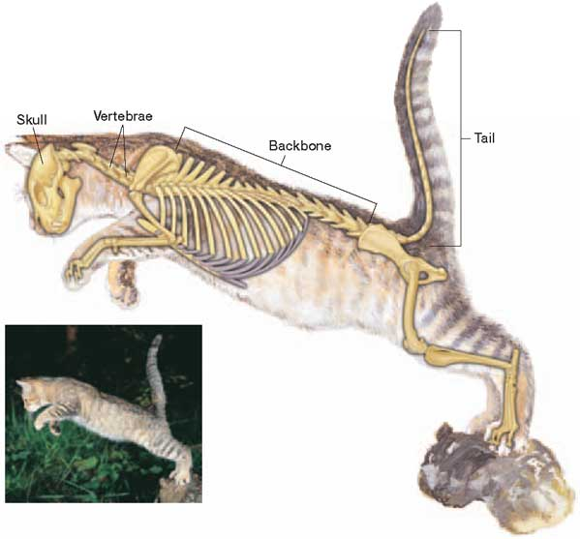
Vertebrate Skeleton
Section 2 Invertebrates and Vertebrates
Chapter 32

Slide 24
Vertebrate Characteristics, continued
Section 2 Invertebrates and Vertebrates
Chapter 32
Body Coverings
The outer covering of an animal is called the _________________.
The integuments of fishes and most amphibians are adapted only to moist environments.
The integuments of most terrestrial vertebrates are adapted to the dry conditions of a terrestrial environment.
Integuments serve other purposes such as ___________, ________________, or __________.

Slide 25
Vertebrate Characteristics, continued
Section 2 Invertebrates and Vertebrates
Chapter 32
Respiratory and Circulatory Systems
Gas exchange occurs in the gills of aquatic vertebrates.
Lungs evolved in terrestrial vertebrates.
Vertebrates have a closed circulatory system with a multichambered heart.
In some vertebrates, the multichambered heart has separate chambers and is thus more efficient.

Slide 26
Open and Closed Circulatory Systems
Section 2 Invertebrates and Vertebrates
Chapter 32

Slide 27
Vertebrate Characteristics, continued
Section 2 Invertebrates and Vertebrates
Chapter 32
Digestive and Excretory Systems
Digestion occurs in the gut.
In many vertebrates, the gut is very long and folded.
Most vertebrates must expel wastes while conserving water.
Most vertebrates convert ammonia to less toxic substances.
In most vertebrates, _____________ filter wastes from the blood while regulating water levels in the body.

Slide 28
Vertebrate Characteristics, continued
Section 2 Invertebrates and Vertebrates
Chapter 32
Nervous System
Vertebrates have highly organized brains, and the control of specific functions occurs in specific centers in the brain.
The structure and function of the nervous system vary among vertebrate classes.
Fishes have limited neural circuitry devoted to simple decision making.
Many mammals display complex and flexible behavior.

Slide 29
Vertebrate Characteristics, continued
Section 2 Invertebrates and Vertebrates
Chapter 32
Reproduction and Development
In most fish and amphibian species, eggs and sperm are released directly into the water, where fertilization takes place.
In reptiles, birds, and mammals, the egg and sperm unite within the body of the female.
The fertilized eggs of many fishes, amphibians, reptiles, and birds develop outside the body. The embryo is nourished by the egg yolk and protected by jellylike layers or a shell.
Most mammals give birth to live offspring. Embryos develop in the female’s body, nourished by the mother’s blood supply until the young are born.
Most vertebrates undergo direct development.

Slide 30
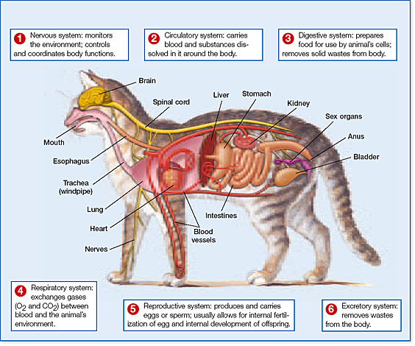
Major Vertebrate Organ Systems
Section 2 Invertebrates and Vertebrates
Chapter 32

Slide 31
Objectives
Section 3 Fertilization and Development
Chapter 32
List the steps of fertilization and development though gastrulation.
List two body parts formed from each germ layer.
Identify the three different body cavity structures of animals.
Name the categories of animals that undergo spiral cleavage and radial cleavage.
Contrast the two processes of coelom formation.

Slide 32
Fertilization and Early Development
Section 3 Fertilization and Development
Chapter 32
In animals, fertilization is the union of haploid female and male gametes to form a single diploid zygote.
Gametes
In most animals, the sperm cell is specialized for movement.
The egg is typically large, with a store of cytoplasm and yolk.
Fertilization
The sperm’s cell membrane fuses with the egg’s cell membrane.
The nucleus of the sperm enters the cytoplasm of the egg.
The nuclei merge to form the diploid nucleus of the zygote.
Replication of DNA begins, and cell division follows.

Slide 33
Fertilization and Early Development, continued
Section 3 Fertilization and Development
Chapter 32
Cleavage and Blastula Formation
_______________ is the series of mitotic cell divisions that follows fertilization.
As cleavage progresses, the divisions rapidly increase the number of cells and yield smaller individual cells.
In most species, cleavage produces a raspberry-shaped mass of 16 to 64 cells.
Then, the mass becomes a hollow ball of cells called a ______________.
The hollow cavity is the blastocoel.

Slide 34
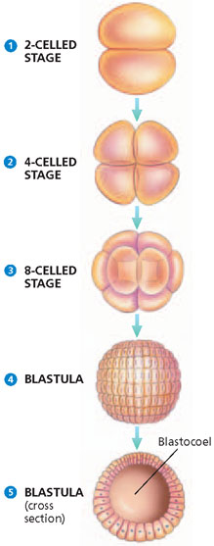
Cleavage and Blastula Formation
Section 3 Fertilization and Development
Chapter 32

Slide 35
Cleavage and Blastula Formation
Section 3 Fertilization and Development
Chapter 32
Click below to watch the Visual Concept.
Visual Concept

Slide 36
Fertilization and Early Development, continued
Section 3 Fertilization and Development
Chapter 32
Gastrulation and Organogenesis
In gastrulation, the blastula folds inward upon itself and transforms into a multilayered embryo called the gastrula.
As the folding continues, the embryo enlarges, and the _______________, or primitive gut, develops.
The open end of the archenteron is the blastopore.
The outer germ layer is the ______________.
The inner germ layer is the _______________.
In most phyla, a third layer, the __________________, forms between the endoderm and the ectoderm.
Each of the germ layers develops into certain organs in a process called organogenesis.

Slide 37
Patterns of Development
Section 3 Fertilization and Development
Chapter 32
The distinct patterns of development in different animal phyla are clues to their phylogenetic history.
Types of Body Cavities
_______________ do not have a body cavity.
A cavity that is not completely lined by mesoderm is called a__________________.
In _________________, mesoderm lines the body cavity, supports the endodermic gut, and forms the attachment for the organs in the coelom.

Slide 38
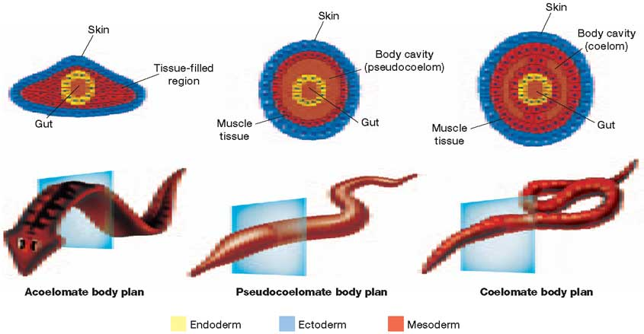
Three Body Plans of Symmetrical Animals
Section 3 Fertilization and Development
Chapter 32

Slide 39
Patterns of Development, continued
Section 3 Fertilization and Development
Chapter 32
Cleavage and Blastopore Fate
There are two distinct patterns of development in coelomates:
In protostomes, the blastopore develops into a mouth, and a second opening forms at the other end of the archenteron, forming an anus.
Many protostomes undergo spiral cleavage.
Protostomes have determinate cleavage.
In deuterostomes, the blastopore develops into an anus, and a second opening at the other end of the archenteron becomes the mouth.
Most deuterostomes undergo radial cleavage.
Deuterostomes have indeterminate cleavage.

Slide 40
Patterns of Development, continued
Section 3 Fertilization and Development
Chapter 32
Coelom Formation
Two patterns of coelom formation occur:
Protostomes exhibit schizocoely, or “split body cavity.”
Deuterostomes exhibit enterocoely, or “gut body cavity.”
In both patterns, mesodermal cells spread out to completely line the coelom, and the blastocoel disappears.
Thus, in both protostomes and deuterostomes, mesoderm lines the interior of the outer body wall and surrounds the gut.

Slide 41
Multiple Choice
Chapter 32
Standardized Test Prep
1. What is the name for the process that leads to cell specialization in multicellular organisms?
A. evolution
B. fertilization
C. differentiation
D. asexual reproduction

Slide 42
Multiple Choice, continued
Chapter 32
Standardized Test Prep
1. What is the name for the process that leads to cell specialization in multicellular organisms?
A. evolution
B. fertilization
C. differentiation
D. asexual reproduction

Slide 43
Multiple Choice, continued
Chapter 32
Standardized Test Prep
2. What process takes place as a zygote begins to divide after fertilization?
F. meiosis
G. cleavage
H. gastrulation
J. organogenesis

Slide 44
Multiple Choice, continued
Chapter 32
Standardized Test Prep
2. What process takes place as a zygote begins to divide after fertilization?
F. meiosis
G. cleavage
H. gastrulation
J. organogenesis

Slide 45
Multiple Choice, continued
Chapter 32
Standardized Test Prep
3. Which animals do not have true tissues?
A. sponges
B. chordates
C. cnidarians
D. ctenophores

Slide 46
Multiple Choice, continued
Chapter 32
Standardized Test Prep
3. Which animals do not have true tissues?
A. sponges
B. chordates
C. cnidarians
D. ctenophores

Slide 47
Multiple Choice, continued
Chapter 32
Standardized Test Prep
4. What are the basic tissue types in an embryo called?
F. coeloms
G. germ layers
H. notochords
J. pharyngeal pouches

Slide 48
Multiple Choice, continued
Chapter 32
Standardized Test Prep
4. What are the basic tissue types in an embryo called?
F. coeloms
G. germ layers
H. notochords
J. pharyngeal pouches

Slide 49
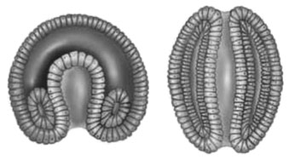
Multiple Choice, continued
Chapter 32
Standardized Test Prep
The diagrams below illustrate a certain type of body-cavity development. Study the diagrams to answer the questions that follow.

Slide 50
Multiple Choice, continued
Chapter 32
Standardized Test Prep
5. The diagrams represent the development of which of the following animals?
A. fish
B. sponge
C. octopus
D. cnidarian

Slide 51
Multiple Choice, continued
Chapter 32
Standardized Test Prep
5. The diagrams represent the development of which of the following animals?
A. fish
B. sponge
C. octopus
D. cnidarian

Slide 52
Multiple Choice, continued
Chapter 32
Standardized Test Prep
6. With which of the following is the process illustrated associated?
F. acoelomates
G. deuterostomes
H. spiral cleavage
J. indeterminate cleavage

Slide 53
Multiple Choice, continued
Chapter 32
Standardized Test Prep
6. With which of the following is the process illustrated associated?
F. acoelomates
G. deuterostomes
H. spiral cleavage
J. indeterminate cleavage

Slide 54
Multiple Choice, continued
Chapter 32
Standardized Test Prep
7. Ectoderm : skin :: mesoderm :
A. lungs
B. nerves
C. vertebrae
D. intestines

Slide 55
Multiple Choice, continued
Chapter 32
Standardized Test Prep
7. Ectoderm : skin :: mesoderm :
A. lungs
B. nerves
C. vertebrae
D. intestines

Slide 56
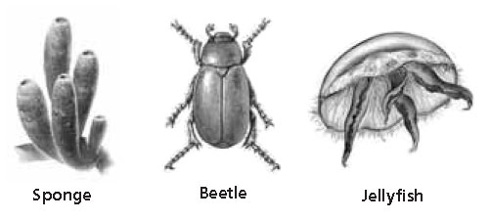
Multiple Choice, continued
Chapter 32
Standardized Test Prep
The diagrams below illustrate different organisms. Study the images to answer the question that follows.

Slide 57
Multiple Choice, continued
Chapter 32
Standardized Test Prep
8. Which of the organisms has radial symmetry?
F. beetle
G. sponge
H. jellyfish
J. both the beetle and the sponge

Slide 58
Multiple Choice, continued
Chapter 32
Standardized Test Prep
8. Which of the organisms has radial symmetry?
F. beetle
G. sponge
H. jellyfish
J. both the beetle and the sponge

Slide 59
Short Response
Chapter 32
Standardized Test Prep
Ctenophores and cnidarians are considered closely related to one another. Chordates and echinoderms are also considered closely related to one another.
Explain how it was determined that cnidarians are less closely related to chordates and echinoderms than they are to ctenophores.

Slide 60
Short Response, continued
Chapter 32
Standardized Test Prep
Ctenophores and cnidarians are considered closely related to one another. Chordates and echinoderms are also considered closely related to one another.
Explain how it was determined that cnidarians are less closely related to chordates and echinoderms than they are to ctenophores.
Answer: Cnidarians and ctenophores have two tissue layers, while chordates and echinoderms have three tissue layers.

Slide 61
Extended Response
Chapter 32
Standardized Test Prep
Base your answers to parts A & B on the information below.
Three types of body-cavity organization exist in animals—acoelomate, pseudocoelomate, and coelomate.
Part A Explain how acoelomates and pseudocoelomates differ from coelomates.
Part B Explain how the lining of the body cavity develops in coelomates.

Slide 62
Extended Response, continued
Chapter 32
Standardized Test Prep
Answer:
Part A: Acoelomates lack a body cavity, and the gut and outer covering are connected by mesoderm. Pseudocoelomates and coelomates have body cavities. In both, the outer body wall is lined with mesoderm. The pseudocoelomate gut is not lined with mesoderm, but the coelomate gut is lined with mesoderm.
Part B: The mesodermal lining in coelomates develops by schizocoely or enterocoely. In schozocoely, cells split away from ectoderm and endoderm and move to the interior of the gastrula to form mesoderm. The mesoderm splits, and the cells divide to line the body cavity and gut. In enterocoely, cells of the archenteron form mesodermal pouches, which spread out to line the cavity and gut.

